Slide 1
An Internship Report Presentation On: “Software Development at Reduct Nepal Pvt.Ltd.”

Slide 2
Introduction
Name: Subash Pandey
College: Oxford College, Butwal
Program: Bachelor of Information management(BIM)
Internship Organization: Reduct Nepal Pvt.Ltd.
Exam Roll Number: 12661/20
TU Registration Number: 7-2-559-29-2020

Slide 3
Placement Details
Department: Tech Team
Position: Full Stack Intern
Duration: 3 Months (Dec 2024 – Mar 2025)
Supervisor: Mr. Avineak Duwal (Tech Lead)
Why I Chose Reduct Nepal:
Forward-Thinking Culture
Alignment with Core Values.
Hands-on Learning Opportunity
Professional Growth.

Slide 4
Tools & Technologies Used
Programming & Frameworks:
Next.js
Google App Scripts
Database:
PostgreSQL
Version Control:
Git / GitHub
Project Management & Methodology:
Agile / Scrum
Collaboration & Design:
Figma (for UI/UX review)
Research & Analysis Tools:
Researched Airbyte and identified Dagster as an ETL tool alternative.

Slide 5
Activities Performed
Core Project
Technical Documentation
System Research
Internal Tool Automation
Quality Assurance
Agile Collaboration

Slide 6
Core Project: Challenges Management System
My Key Contributions:
Full-Stack Development.
Front-End
Back-End
Integration
Documentation

Slide 7
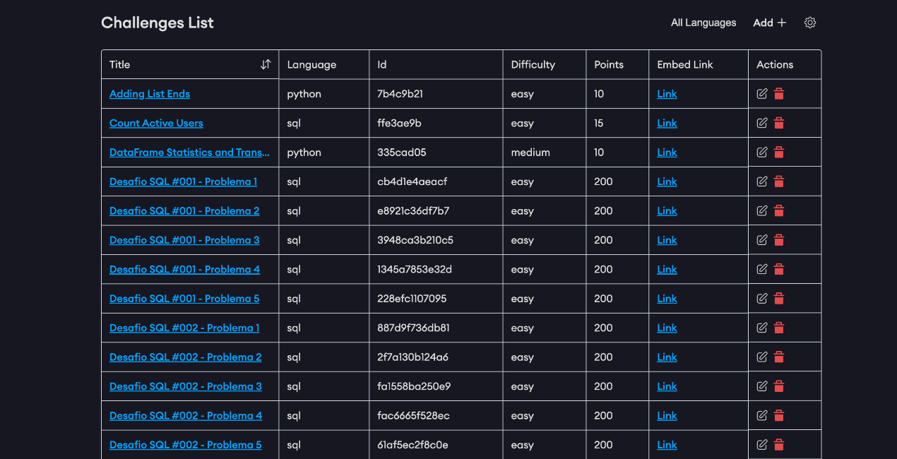
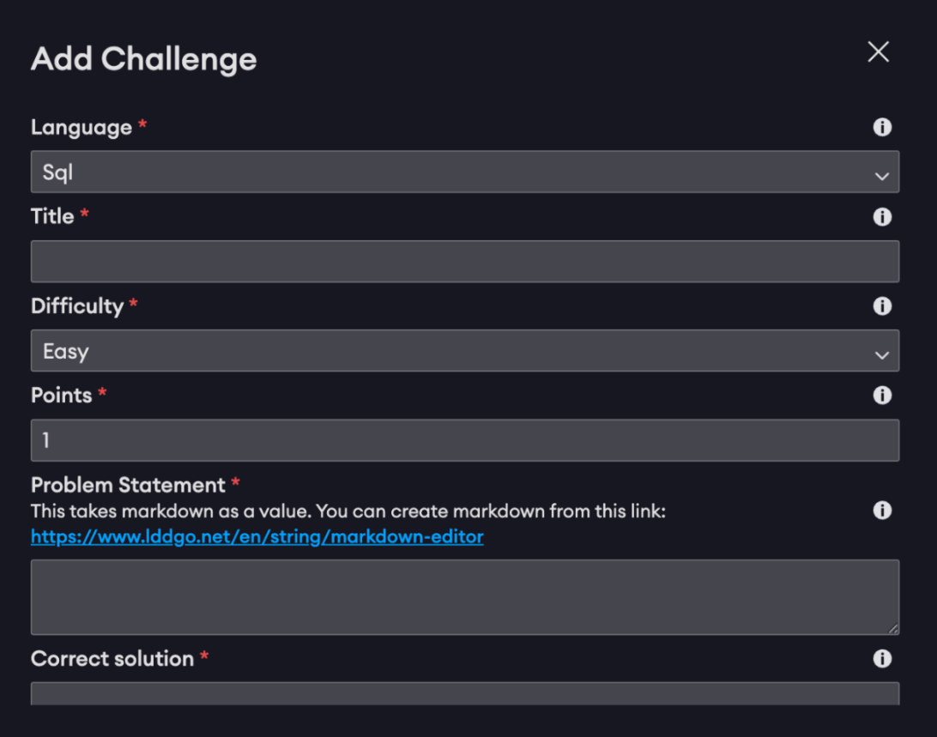
Screenshots of Challenges Management System

Slide 8
Other Key Activities
Technical Documentation for Programiz
ETL Tool Research
Automated Google Form
Reliability Testing

Slide 9
Lessons Learned (Technical Skills)
Full-Stack Development
Database Management
Version Control Mastery
Importance of Documentation
System Analysis

Slide 10
Lessons Learned (Professional Skills)
Agile Methodology in Practice
Effective Communication
Problem-Solving & Initiative
Time Management & Accountability
Receiving Constructive Feedback

Slide 11
Conclusion
The internship at Reduct Nepal provided an enriching experience that successfully bridged the gap between academic knowledge and industry practice.
I was able to contribute to meaningful projects, which enhanced my technical skills in full-stack development and professional skills in communication and project management.
This experience has solidified my passion for software development and has prepared me for a future career in the IT industry.

Slide 12
Thank You

